Slide 1
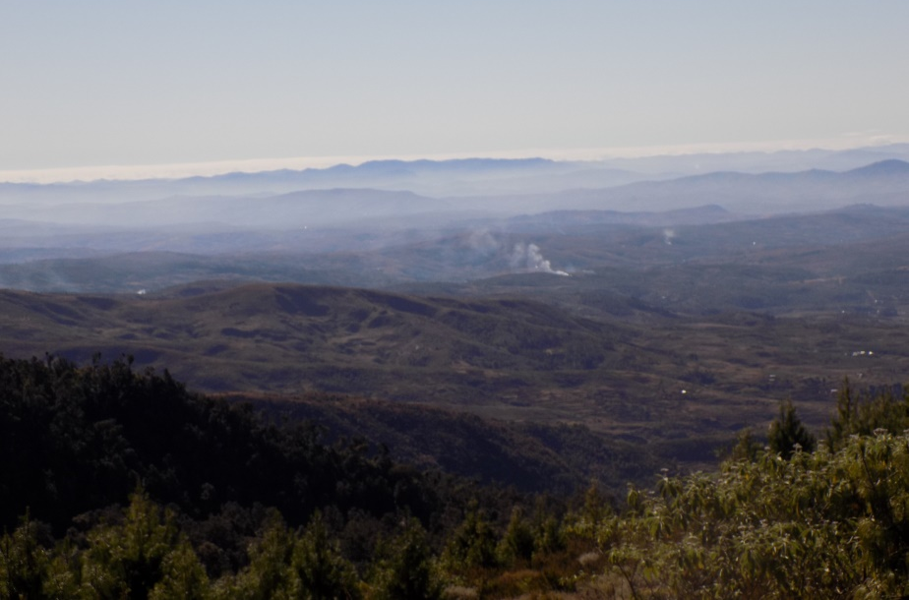
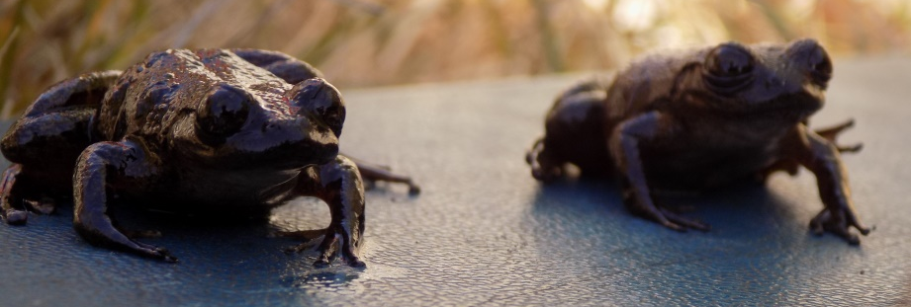
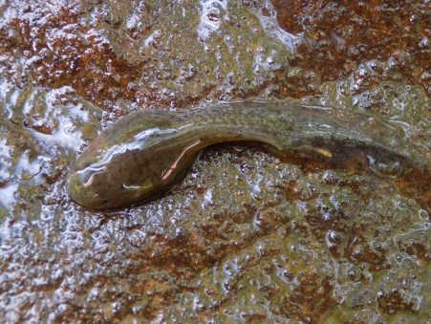
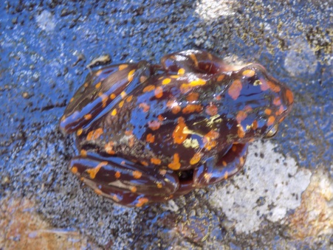
Assessing the role of landscape change on Boophis williamsi population and viability,
Manjakatompo Ankaratra New Protect Area .
Amphibian populations globally are declining as a consequence of environmental change and increasing human pressures. The Ankaratra Massif of central Eastern Madagascar has been severely affected by deforestation and widespread fires over recent years. These threats have contributed to extensive habitat. The aim is to assess the impact of anthropogenic encroachment, and specifically to identify the role of landscape change on Boophis williamsi population (abundance and viability).
Statistical model :
What is the relationship between landscape change and Boophis williamsi abundance?
Mechanistic model :
How does captive breading in-situ influence Boophis williamsi population abundance?

Slide 2
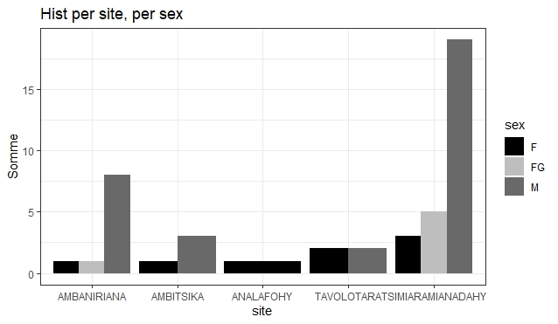
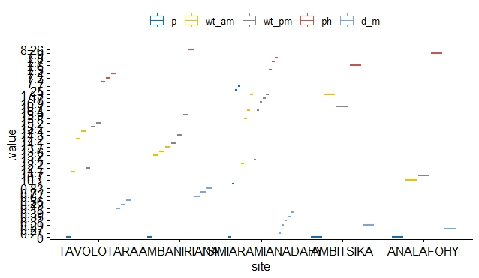
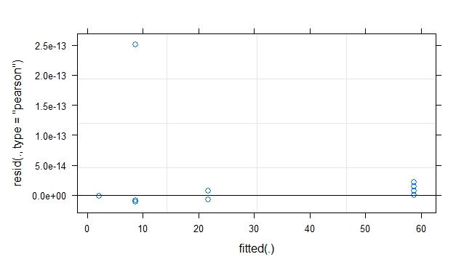
Statistical model
Question : What is the relationship between landscape change and Boophis williamsi abundance?
Hypothesis: Landscape change affects Boophis williamsi abundance and size.
Response variable: Population abundance (population size)
Predictor variables (x1, x2…xn): morphometric parameters (TL, SVL, HW, Weight, sex, development stage), physic and stream’s physicochemical parameters (pH, T°, depth, width), ecological parameters (substratum and plant coverage rate).
Family: Poisson
Link: log
R code:
lmer(frog abundance~x1+x2+…+xn+(1I transect), data=data)

Slide 3
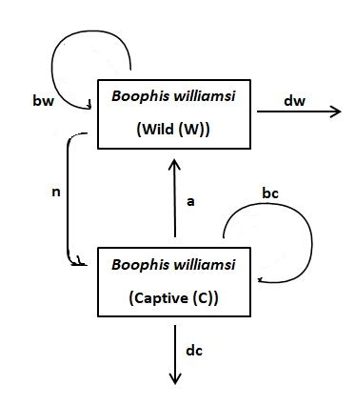

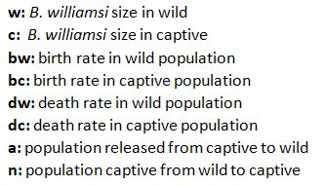

Dynamical model
Question : How does captive breading in-situ influence Boophis williamsi population abundance?
Hypothesis: Captive breading in-situ increases population abundance.
Equations:

Slide 4
Next steps
The next steps are to analyse deeply the data for demonstrative hypothesis and resolving statistical and dynamical questions.
Acknowledgement
Thanks for al E2M2 and C4C students for them huge help.
Thanks for all E2M2 staff, organizers and partenrs for the program which is very helpful and instructive.

